Slide 1
TITLE: Unregistered Vehicle recognition based on Number plate using Raspberry Pi DOMAIN: MACHINE LEARNING
GUIDE: Mrs. M.Sangeetha M.Tech
BATCH – A4
V. JAYAVARSHINI(211417104093)
B.JOTHIKA(211417104101)
R.KUSHMITHA(211417104127)

Slide 2
ABSTRACT
The automated object detection algorithm is really important component in the smart cities application to process the digitized images searching vehicle license plate.
An USB camera is attached with raspberry pi as a processing unit to detect the number plates in traffic signals and image processing technology to search for a number plate in a given image frame.
Extracted vehicle numbers are compared with existing database, if the number of vehicle is not in registered list it send the number and image of vehicle to the control station through mail.

Slide 3
LITERATURE SURVEY
S. No | Year | Author name | Paper title | Merits | Demerits
1 | 2015 | Baoguang Shi, Xiang Bai and Cong Yao, IEEE Transactions on Pattern Analysis and Machine Intelligence ( Volume: 39, Issue: 11, Nov. 1 2017) | An End-to-End Trainable Neural Network for Image-based Sequence Recognition and Its Application to Scene Text Recognition | The advantages of RNN is that it does not need the position of each element in a sequence object image in both training and testing. A preprocessing step that converts an input object image into a sequence of image features, is usually essential. | The problem of scene text recognition, which is among the most important and challenging tasks in image-based sequence recognition.
2 | 2017 | Jiangmin Tian, Guoyou Wang, " Journal of Electronic Imaging 26(3), 033017 (27 May 2017). https://doi.org/10.1117/1.JEI.26.3.033017 | License plate detection in an open environment by density-based boundary clustering | The detection of boundary is simple and fast. The more information about license plate is available | The main disadvantage is the variation of background, illumination, and view point, license plate detection in an open environment is challenging. It is too time consuming for application with time requirement.

Slide 4
S. No | Year | Author name | Paper title | Merits | Demerits
3 | 2017 | Hui Li, Peng Wangy, and Chunhua Shen, IEEE Transactions on Intelligent Transportation Systems ( Volume: 20, Issue: 3, March 2019) | Towards End-to-End Car License Plates Detection and Recognition with Deep Neural Networks | The advantage of end-to-end training for both detection and recognition in an unified network. The sharing of convolutional features with both detection and recognition network, the model size decreases largely. | It does not explicitly handle the rotated plates. Edge-based methods are fast in computation, but they cannot be applied to complex images as they are too sensitive to unwanted edges.
4 | 2016 | Chao Gou, KunfengWang, Yanjie Yao, and Zhengxi Li, IEEE Transactions on Intelligent Transportation Systems ( Volume: 17, Issue: 4, April 2016) | Vehicle License Plate Recognition Based on Extremal Regions and Restricted Boltzmann Machines | The license plate by using a geometric template on connected target pixels with the same color. These methods can detect license plate regions in relatively simple environments. | This may become invalid when there are regions in the image whose color information is similar to that of the license plate.It can easily be affected by noises and are computationally complex when there are many edges in the image.

Slide 5
S. No | Year | Author name | Paper title | Merits | Demerits
5 | 2016 | Annie J. Zenath M.S, S. Shriram, IOSR Journal of Electronics and Communication Engineering (IOSR-JECE) e-ISSN: 2278-2834,p- ISSN: 2278-8735. PP 142-147 | Licence Plate Localization And Recognition Using Mser And Swt Algorithms | The neural network has advantage from existing correlation and statistics template techniques that allow being stable to noises and some position modifications of characters on license | If the training time is a critical factor then the network having single hidden layer. The template matching has its drawbacks in some aspects comparing with neural networks.
6 | 2016 | D. F. Llorca, C. Salinas, M. Jim´enez, I. Parra, A. G. Morcillo, R. Izquierdo, J. Lorenzo, M. A. Sotelo, 2016 IEEE 19th International Conference on Intelligent Transportation Systems (ITSC) | Two-camera based accurate vehicle speed measurement using average speed at a fixed point | The system is run once the vehicle license plate is located by the first camera, and stopped once it is not visible by the second one.The Highresolution and high-speed cameras with a narrow field . | The accurate speed detection of moving vehicles is a key issue to traffic law enforcement in most countries that may lead to an effective reduction in the number of road accidents and fatalities. It provides the minimum speed error independently of the speed of the vehicle.

Slide 6
S. No | Year | Author name | Paper title | Merits | Demerits
7 | 2016 | Max Jaderberg1 · Karen Simonyan1 · Andrea Vedaldi1 Int J Comput Vis (2016) 116:1–20 DOI 10.1007/s11263-015-0823-z SPRINGER | Reading Text in theWild with Convolutional Neural Networks | An end-to-end system for text spotting—localizing and recognizing text in natural scene images—and text based image retrieval.This system is based on a region proposal mechanism for detection and deep convolutional neural networks for recognition. | This places text spotting as a separate, far more challenging problem than document OCR.This model was extended to CAPTCHA sequences up to 8 characters long where they demonstrated impressive performance using synthetic training data for a synthetic problem
8 | 2017 | Zied Selmi, Mohamed Ben Halima, 2017 14th IAPR International Conference on Document Analysis and Recognition (ICDAR) | Deep Learning System for Automatic License Plate Detection and Recognition | The The detection and recognition of a vehicle License Plate (LP) is a key technique in most of the applications related to vehicle movement.It is a quite popular and active research topic in the field of image processing. | Some frameworks require complicated hardware to make good quality images or capture images from vehicles with very slow speed.Detection and recognition of LPs in different conditions and under several climatic variations remains always difficult to realize with good results

Slide 7
S. No | Year | Author name | Paper title | Merits | Demerits
9 10 | 2016 2018 | Minghui Liao_, Baoguang Shi_, Xiang Baiy, Xinggang Wang, Wenyu, Vol. 31 No. 1 (2017): Thirty-First AAAI Conference on Artificial Intelligence Zhenbo Xu, Proceedings of the European Conference on Computer Vision (ECCV), 2018, pp. 255-271 | TextBoxes: A Fast Text Detector with a Single Deep Neural Network Towards End-to-End License Plate Detection and Recognition: A Large Dataset and Baseline | TextBoxes outperforms competing methods in terms of text localization accuracy and is much faster, taking only 0.09s per image in a fast implementation.TextBoxes significantly outperforms state-of-the-art approaches on word spotting and end-to-end text recognition tasks To our best knowledge, CCPD is the largest publicly available LP dataset to date with over 250k unique car images, and the only one provides vertices location annotations. Through comparative experiments, we demonstrate our model outperforms current object detection and recognition approaches in both accuracy and speed. | Owing to the inevitable challenges and complexities, traditional text detection methods tend to involve multiple processing steps.TextBoxes directly outputs the coordinates of word bounding boxes at multiple network layers by jointly predicting text presence and coordinate offsets to default boxes An imperfect bounding box prediction given by detection methods might make a part of the LP missing, and thus results in the subsequent recognition failure. Operations between different stages such as extracting and resizing the LP region for recognition are always accomplished by less efficient CPU, making LP recognition slower.

Slide 8
TECHNOLOGY STACK
Hardware Requirements:
Raspberry Pi 3
USB Camera
Software Requirements:
Language : Python
Compiler : GCC Complier.
OS :Linux
Database:
MySQL

Slide 9
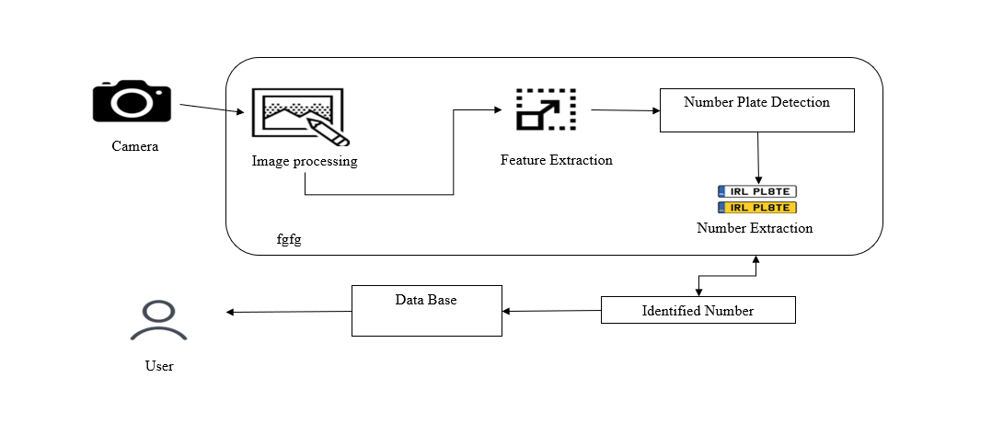
SYSTEM ARCHITECTURE
RASBERRY PI

Slide 10
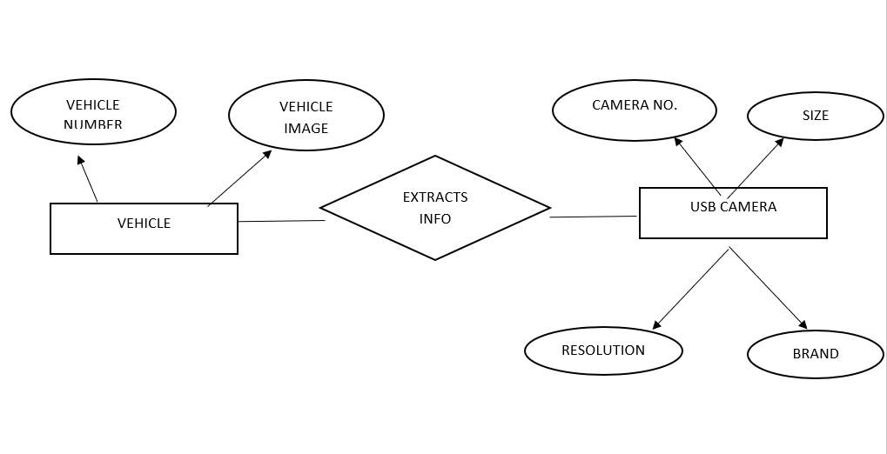
UML DIAGRAM ER Diagram

Slide 11
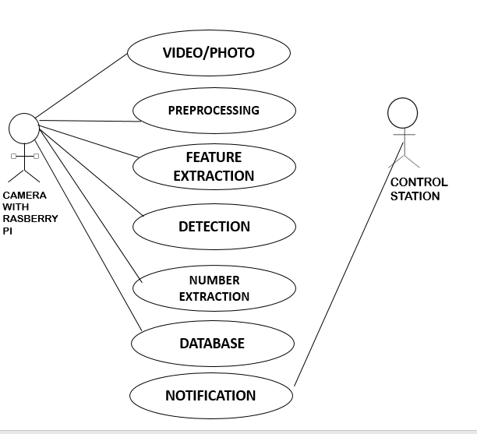
UML DIAGRAM
USE CASE DIAGRAM

Slide 12
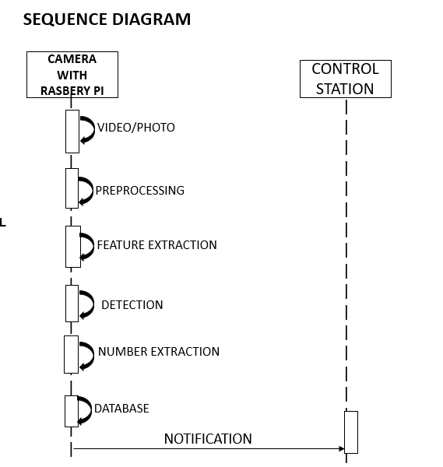
UML DIAGRAM SEQUENCE DIAGRAM

Slide 13
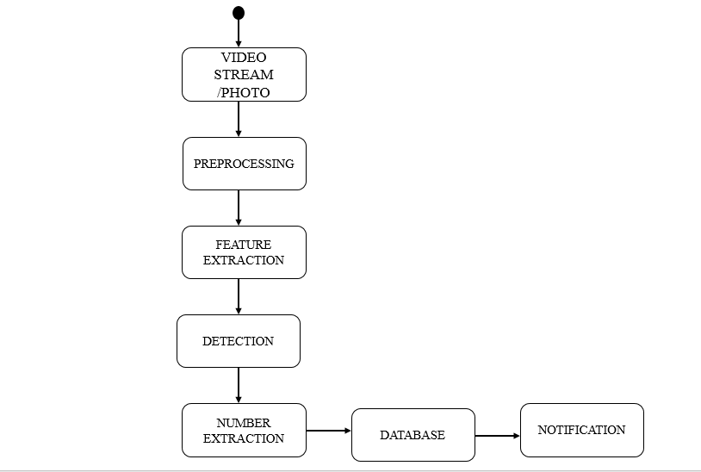
UML DIAGRAM ACTIVITY DIAGRAM

Slide 14

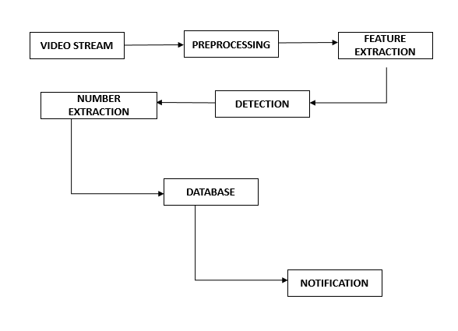
UML DIAGRAMS

Slide 15
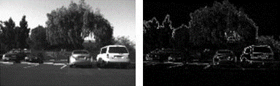
ALGORITHMS
EDGE DETECTION TECHNIQUE
Edge detection is an image processing technique for finding the boundaries of objects within images. It works by detecting discontinuities in brightness. Edge detection is used for image segmentation and data extraction in areas such as image processing, computer vision, and machine vision. Most of the shape information of an image is enclosed in edges. So first we detect these edges in an image and by using these filters and then by enhancing those areas of image which contains edges, sharpness of the image will increase and image will become clearer.

Slide 16
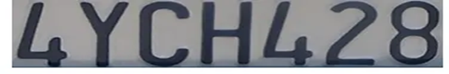
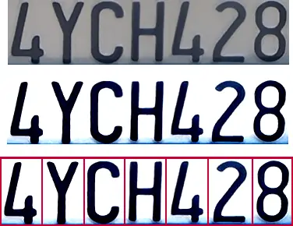
OPTICAL CHARACTER RECOGNITION
Optical character recognition is the electronic or mechanical conversion of images of typed, handwritten or printed text into machine-encoded text, whether from a scanned document, a photo of a document, a scene-photo or from subtitle text superimposed on an image.
This algorithm detect specific portions or shapes of a digitized image or video stream. OCR software often pre-processes images to improve the chances of successful recognition. In this way, unwanted distortions are suppressed and specific image features are enhanced.
OCR
OCR

Slide 17
MODULE DESCRIPTION
Image Capturing
Image Frame cleaning and preprocessing
Detecting number plate using contours
Transforming Number plate image to text

Slide 18
1. IMAGE CAPTURING:
In this module we create a basic infrastructure to establish the proposed feature of image handling in python. Prepare the python environment to access video input device, in this case a camera.
2. IMAGE FRAME CLEANING AND PREPROCESSING:
Once the image is read in python we use different image processing technique on the image. The number plate detection technique is deployed. First the image is converted to grey scale image. This means the pixel value will be stripped off the color values and converted to the grayscale. The pixel will have a value of 1byte per pixel which means any value between 0-255 is used. The grayscale image is then processed to find out possible number plate area using edge detection technique.

Slide 19
3. DETECTING NUMBER PLATE USING CONTOURS:
After edge detection, all high intensity pixels were scanned from left to right in the X axis and top to bottom for Y axis. The concentration of white pixels will give a fair knowledge of where the more number of edges were available in x-axis. This will give the approximate starting location of x-axis. Concentration of white pixels in y-axis is also scanned to get the approximate location of the y-axis. Due to the variable text or images available in the vehicle, we may have more than one region of interest of the number plate.
4. TRANSFORMING NUMBER PLATE IMAGE TO TEXT:
The region of interest for the number plate area was detected from the previous module. We will try to fit the number plate area and ratio of width and height. If the possible number plates region is identified, the image is cropped for the dimension of the detected number plate. Then the convolution neural network (CNN) algorithm is performed. The number plate image is then processed with simple optical character recognition software to convert to a text.

Slide 20
TEST REPORT
TEST CASE NO. | TEST CASE DESCRIPTION | TEST DATA | EXPECTED RESULT | ACTUAL RESULT | PASS/FAIL
1 | Extract the correct number from the image through USB camera and identify as registered vehicle. | An empty frame shown in the USB camera. | Nothing detected | Nothing detected | Pass
2 | Extract the correct number from the image through USB camera and identify as registered vehicle. | A vehicle number plate shown in the USB camera. | The number plate should be recognized as TN 57 AK 1234 (registered vehicle) | Number plate recognized as TN 57 AK 1234 (registered vehicle) | Pass
3 | Extract the correct number from the image through USB camera and identify as unregistered vehicle. | A vehicle number plate shown in the USB camera. | The number plate should be recognized as HR 26 DK 8337 (unregistered vehicle) | Number plate recognized as HR 26 DK 8337 (unregistered vehicle) | Pass
4 | Extract the correct number from the image through USB camera and identify as unregistered vehicle. | A vehicle number plate shown in the USB camera. | The number plate should be recognized as 1433 (unregistered vehicle) | Number plate recognized as 1433 (unregistered vehicle) | Pass
5 | Extract the correct number from the image through USB camera and identify as unregistered vehicle. | A vehicle number plate shown in the USB camera. | The number plate should be recognized as CG 04 MF 2250 (unregistered vehicle) | Number plate recognized as CG 04 MF 2250 (unregistered vehicle) | Pass

Slide 21

SCREENSHOTS

Slide 22
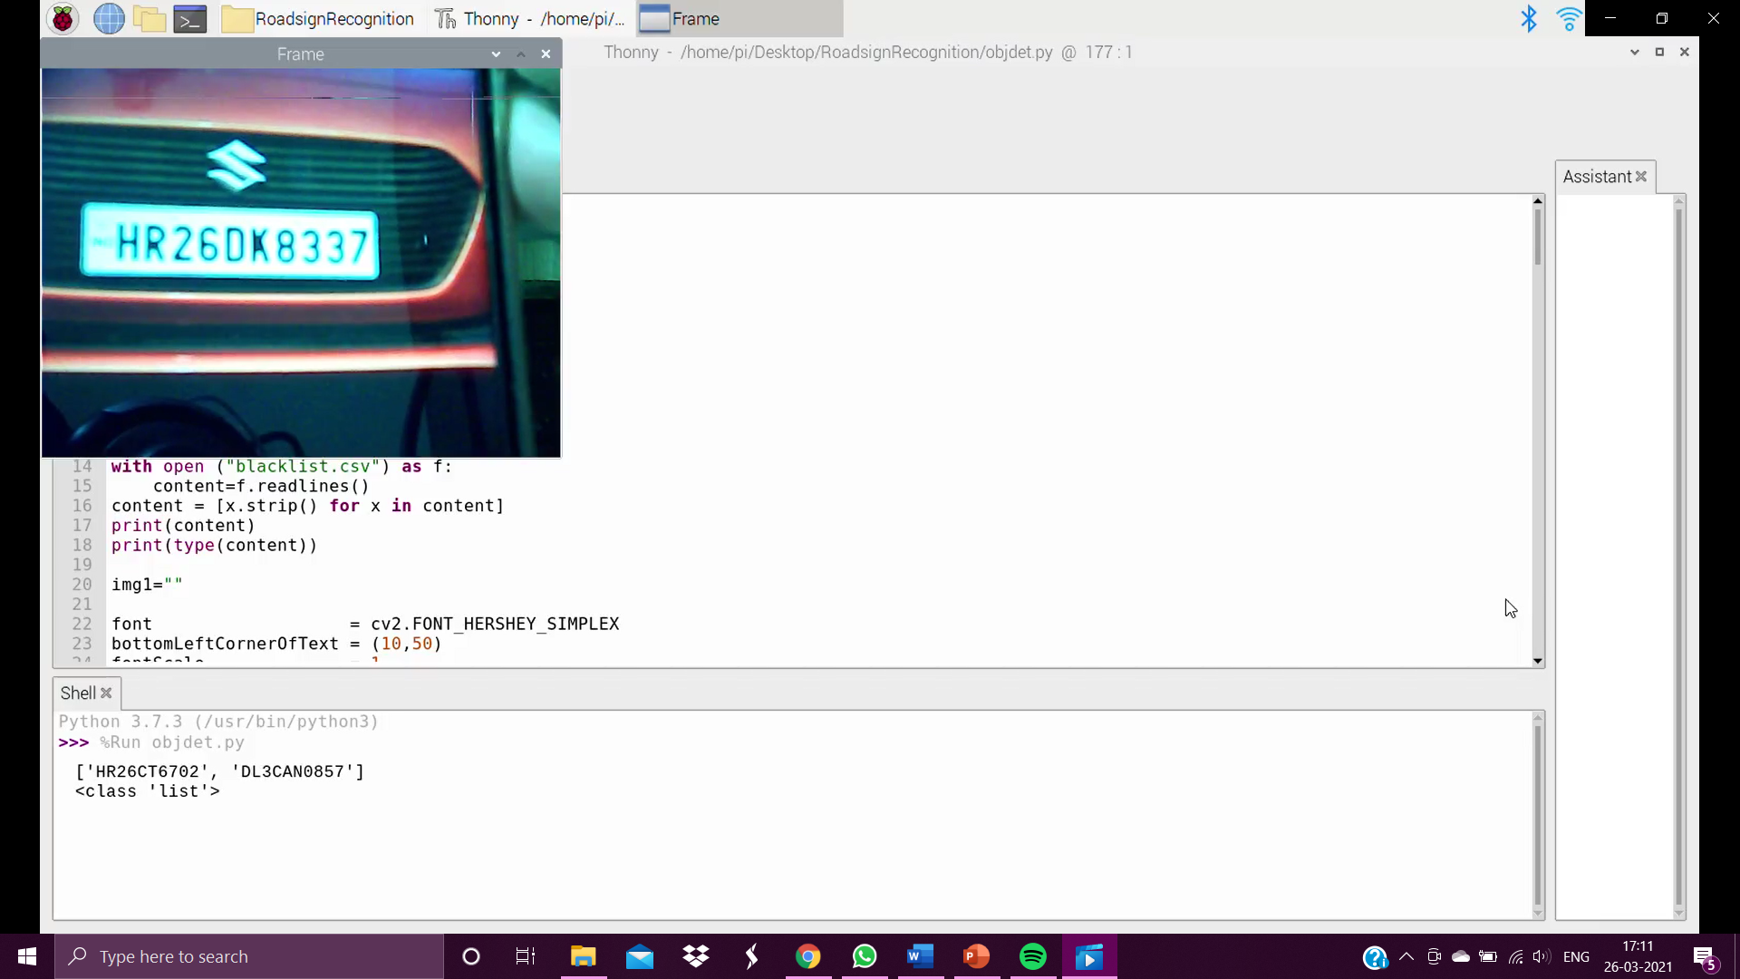

Slide 23
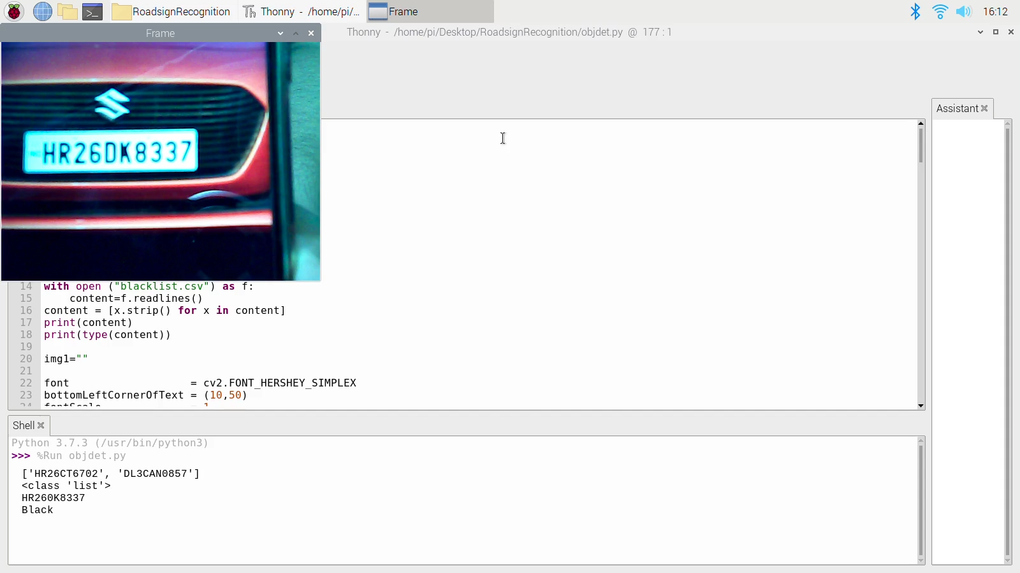

Slide 24


Slide 25
PUBLICATION DETAILS
JOURNAL NAME-International Research Journal of Modernization in Engineering Technology and Science
UNREGISTERED VEHICLE RECOGNITION BASED ON NUMBER PLATE USING RASPBERRY PI
S.NO: e-ISSN: 2582-5208 Volume:03/Issue:06/June-2021 Impact Factor- 5.354[776]

Slide 26
CONCLUSION AND FUTURE ENHANCEMENTS
Thus in the unregistered vehicle recognition using raspberry pi we have overcome all the drawbacks till date. We have used the simplest algorithms and have reduced the time of the output. Our system also adapts to all the climatic conditions .Using this system, we can prevent illegal activities using unregistered or fake numbered vehicles .It is a low cost and efficient surveillance system when compared to present systems are used . This system is compact and portable model.

Slide 27
REFERENCES
1. Baoguang Shi, Xiang Bai and Cong Yao “An End-to-End Trainable Neural Network for Image-based Sequence Recognition and Its Application to Scene Text Recognition” 2015, IEEE Transactions on Pattern Analysis and Machine Intelligence ( Volume: 39, Issue: 11, Nov. 1 2017)
2. Max Jaderberg1 · Karen Simonyan1 · Andrea Vedaldi1 “Reading Text in theWild with Convolutional Neural Networks” 2016, Int J Comput Vis (2016) 116:1–20 DOI 10.1007/s11263-015-0823-z SPRINGER
3. Chao Gou, KunfengWang, Yanjie Yao, and Zhengxi Li“Vehicle License Plate Recognition Based on Extremal Regions and Restricted Boltzmann Machines” 2016, IEEE Transactions on Intelligent Transportation Systems ( Volume: 17, Issue: 4, April 2016)
4. Annie J. Zenath M.S, S. Shriram “Licence Plate Localization And Recognition Using Mser And Swt Algorithms” 2016, IOSR Journal of Electronics and Communication Engineering (IOSR-JECE) e-ISSN: 2278-2834,p- ISSN: 2278-8735. PP 142-147
5. . D. F. Llorca, C. Salinas, M. Jim´enez, I. Parra, A. G. Morcillo, R. Izquierdo, J. Lorenzo, M. A. Sotelo “Two-camera based accurate vehicle speed measurement using average speed at a fixed point” 2016, 2016 IEEE 19th International Conference on Intelligent Transportation Systems (ITSC)
6. Minghui Liao_, Baoguang Shi_, Xiang Baiy, Xinggang Wang, Wenyu “TextBoxes: A Fast Text Detector with a Single Deep Neural Network”2016, Vol. 31 No. 1 (2017): Thirty-First AAAI Conference on Artificial Intelligence
7. Jiangmin Tian, Guoyou Wang “License plate detection in an open environment by density-based boundary clustering” 2017, Journal of Electronic Imaging 26(3), 033017 (27 May 2017). https://doi.org/10.1117/1.JEI.26.3.033017
8. Zied Selmi, Mohamed Ben Halima “Deep Learning System for Automatic License Plate Detection and Recognition” 2017, 2017 14th IAPR International Conference on Document Analysis and Recognition (ICDAR)
9. Hui Li, Peng Wangy, and Chunhua Shen “Towards End-to-End Car License Plates Detection and Recognition with Deep Neural Networks” 2017, Proceedings of the European Conference on Computer Vision (ECCV), 2018, pp. 255-271
10. Zhenbo Xu1 “Towards End-to-End License Plate Detection and Recognition: A Large Dataset and Baseline” 2018, Proceedings of the European Conference on Computer Vision (ECCV), 2018, pp. 255-271

